Slide 1
Program Testing
A competent programmer should know several correct answers that a program should compute, before writing a single line of code.
We will make extensive use of assertEqual() to automate testing of functions.
from cisc106_34 import assertEqual
assertEqual(function_name(…), <expected answer>)

Slide 2
PEP 257 – Doc String Conventions
The docstring for a function or method should summarize its behavior and document its arguments, return value(s), side effects, exceptions raised, and restrictions on when it can be called (all if applicable). Optional arguments should be indicated. It should be documented whether keyword arguments are part of the interface.
The docstring for a function or method should summarize its behavior and document its arguments, return value(s), side effects, exceptions raised, and restrictions on when it can be called (all if applicable). Optional arguments should be indicated. It should be documented whether keyword arguments are part of the interface.

Slide 3
Documentation
Python Doc String
A description of what a program or function does, and how to use it.
Think of this as a contract.
def my_function(parameters…):
'''
A Description of what the function does.
Parameters:
param_1 (type) – description
param_2 (type) – description
…
Returns:
var_1 (type) – description
'''
<python statements>

Slide 4
Accessing the Doc String
help(my_function)
my_function.__doc__
print(my_function.__doc__)

Slide 5
Reverse a Number
Write a function that takes a 2 digit integer and calculates the ‘reverse’ of that integer.
Example:
integer = 37
result = 73
Approach:
Find 1’s digit and 10’s digit
1’s digit = 37 % 10
10’s digit = 37 // 10
Construct result
result = (1’s digit) * 10 + 10’s digit

Slide 6
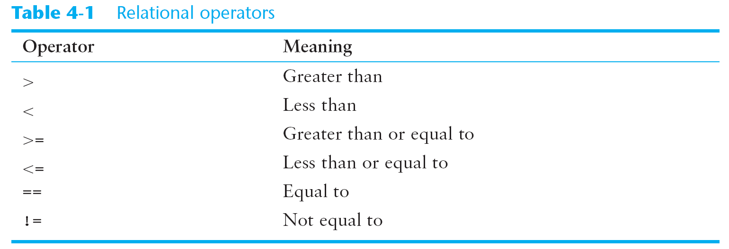

Slide 7
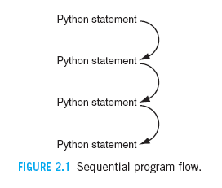
Flow of Control: Sequential (default)
start here

Slide 8
Flow of Control: Function Call
def function_name (parameters…):
Python statement
Python statement
Python statement
return value
start here
x = function_name (arguments…)

Slide 9
Conditionals
if (condition) – then do …
if (condition) – then do … – else do …
if (condition) – then do … – elif (condition) – then do … – elif (condition) – then do … … – else do …

Slide 12
Flow of Control: if
False

Slide 13
Flow of Control: if –else

Slide 14
The if and if-else Statements
if statement
if-else statement
if <Boolean expression>:
<python statements>
.
.
.
if block
Required colon here
if <Boolean expression>:
python statements>
.
.
.
else:
python statements>
.
.
.
if block
Required colon here and here
else block

